Slide 1

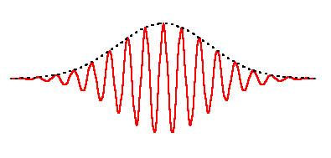
Fiber Optic Communications
Lecture 4
Stephen E. Ralph
Fiber Modes
Multimode Fiber
Spring 2026
V_{g}
V_{ph}

Slide 2
Homework Due Wednesday 4 Feb 2026
Review basic E&M, Chapter 1 Kumar and Deen
Plane waves, relationships between wavelength, velocity, k-vector
Phase and group velocity, physical meaning and mathematical definition
Read Chapter 2 and 3 Kumar and Deen
Read Journal articles
Fiber-optic transmission and networking: the previous 20 and the next 20 years,
P. J. Winzer, D. T. Neilson, and A. R. Chraplyvy
Future Optical Networks
Michael J. O’Mahony, Christina Politi, Dimitrios Klonidis, Reza Nejabati, and Dimitra Simeonidou, JLT V24, 2006

Slide 3
Kumar and Deen Problems 1.9,
Kumar and Deen 1.15
Pulse Propagation
Compute and plot the temporal shape and spectral content of a single optical pulse. Assume the carrier is essentially monochromatic at center wavelength 1552nm (plot both amplitude and phase, use a frequency axis centered on the carrier and denote frequency offset from carrier in units of GHz). The pulse should have the following characteristics:
a) Single raised cosine pulse with pulse width corresponding to 32 Gbps, and excess bandwidth factor of 0.1. The FWHM should be = symbol slot T.
b) Roughly estimate the temporal spread of the pulse after 10km and 100km in standard fiber. (Suggestion: estimate Δf to be =1/T).
c) The pulse in part a) after propagating through 10km and 100km of standard fiber. Neglect loss (α=0) and nonlinear (intensity dependent) effects. Plot the temporal shape. Indicate both real time units (ps) and a bit slot unit. Choose a time scale appropriate for the anticipated temporal spread i.e. at least 10ns for the 1000km case. You also need sufficient temporal resolution, at least 20points in the original pulse shape or ~1ps.
Also plot the phase in the frequency domain. Show only the quadratic phase behavior (i.e. remove any linear phase behavior). Be sure to unwrap any phase discontinuities.

Slide 4
4) A Gaussian pulse (100ps FWHM) is launched into 80km of SSMF fiber with initial power of +15 dBm. The central wavelength of the pulse is 1550nm. State clearly any assumptions.
a) If you measure the power at the end of the fiber, what value are you likely to observe? (Answer both in mW and dBm)
b) What is the loss parameter α?
c) What is the pulse width (FWHM) at the end of the fiber?
d) At the input to the fiber what is the spectral content (Δω FWHM ) if the pulse initially unchirped?
e) At the output of the fiber the pulse is chirped. Is it positively or negatively chirped? Does this mean the “blues” are ahead of or behind the “reds”? What is the spectral content (Δω FWHM )?
f) What is the value of the chirp parameter at the output of the fiber? Write an expression for the pulse shape which includes the chirp parameter.

Slide 5
Waves Summary
Wave Equation(1D case)
3D with E = E e^{iωt}
Solution
where
Examination of constant phase of the argument of the cosine solution yields the phase velocity
Examination of the cosine solution in the wave equation shows
Known as the dispersion relation, i.e. how k (space) relates to ω (time)
Thus
Phase velocity in vacuum

Slide 6
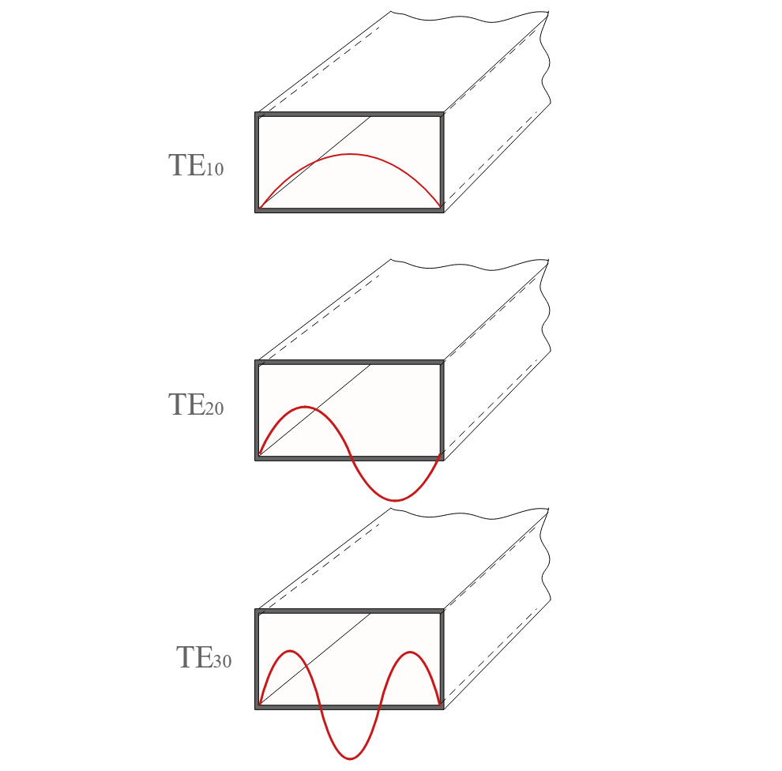
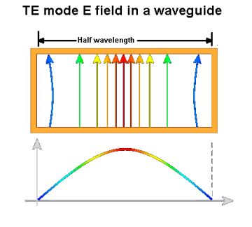
Electromagnetic Modes
MODES: Stable electric field distributions in waveguides, optical resonators or in free space that satisfy Maxwell’s equations and boundary conditions
WAVEGUIDE MODES: Solution of the wave equation that satisfies the boundary conditions and has a spatial distribution does not change with propagation
Normal E-field starts and terminates with charge
Tangential E-field is zero at conductor
Confined structures: Waveguide Modes
For waveguides, the stable condition for a mode requires that the shape of the complex amplitude profile in the transverse dimensions remains exactly constant
For metal waveguides the E-field must be zero at the metal boundary
Metal Waveguide

Slide 7
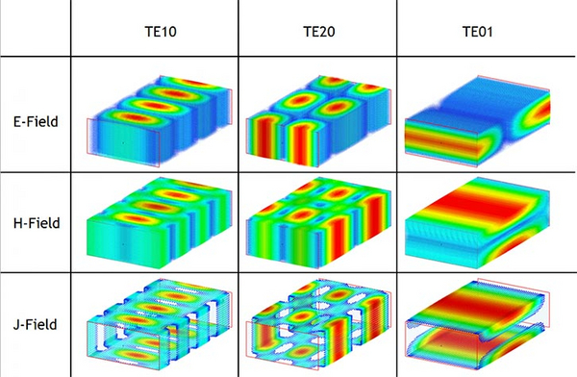
Mode Classification
Transverse electromagnetic (TEM) modes
Neither electric nor magnetic field in the direction of propagation
Transverse electric (TE) modes
No electric field in the direction of propagation. These are sometimes called H modes because there is only a magnetic field along the direction of propagation (H is the conventional symbol for magnetic field)
Transverse magnetic (TM) modes
No magnetic field in the direction of propagation. These are sometimes called E modes because there is only an electric field along the direction of propagation
Hybrid modes
Non-zero electric and magnetic fields in the direction of propagation
Rectangular transverse mode patterns TEM(mn)

Slide 8
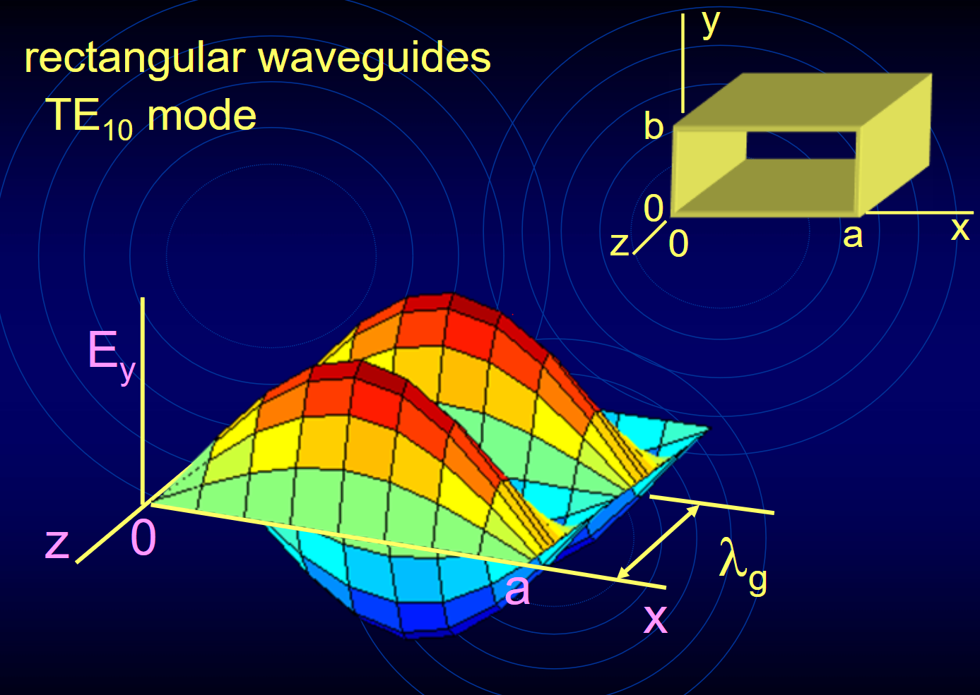
Electromagnetic Modes
MODES: Stable electric field distributions in waveguides, optical resonators or in free space that satisfy Maxwell’s equations and boundary conditions
WAVEGUIDE MODES: Solution of the wave equation that satisfies the boundary conditions and has a spatial distribution does not change with propagation
Confined structures: Waveguide Modes
For waveguides, the stable condition for a mode requires that the shape of the complex amplitude profile in the transverse dimensions remains exactly constant
For metal waveguides the E-field must be zero at the metal boundary
Metal Waveguide

Slide 9
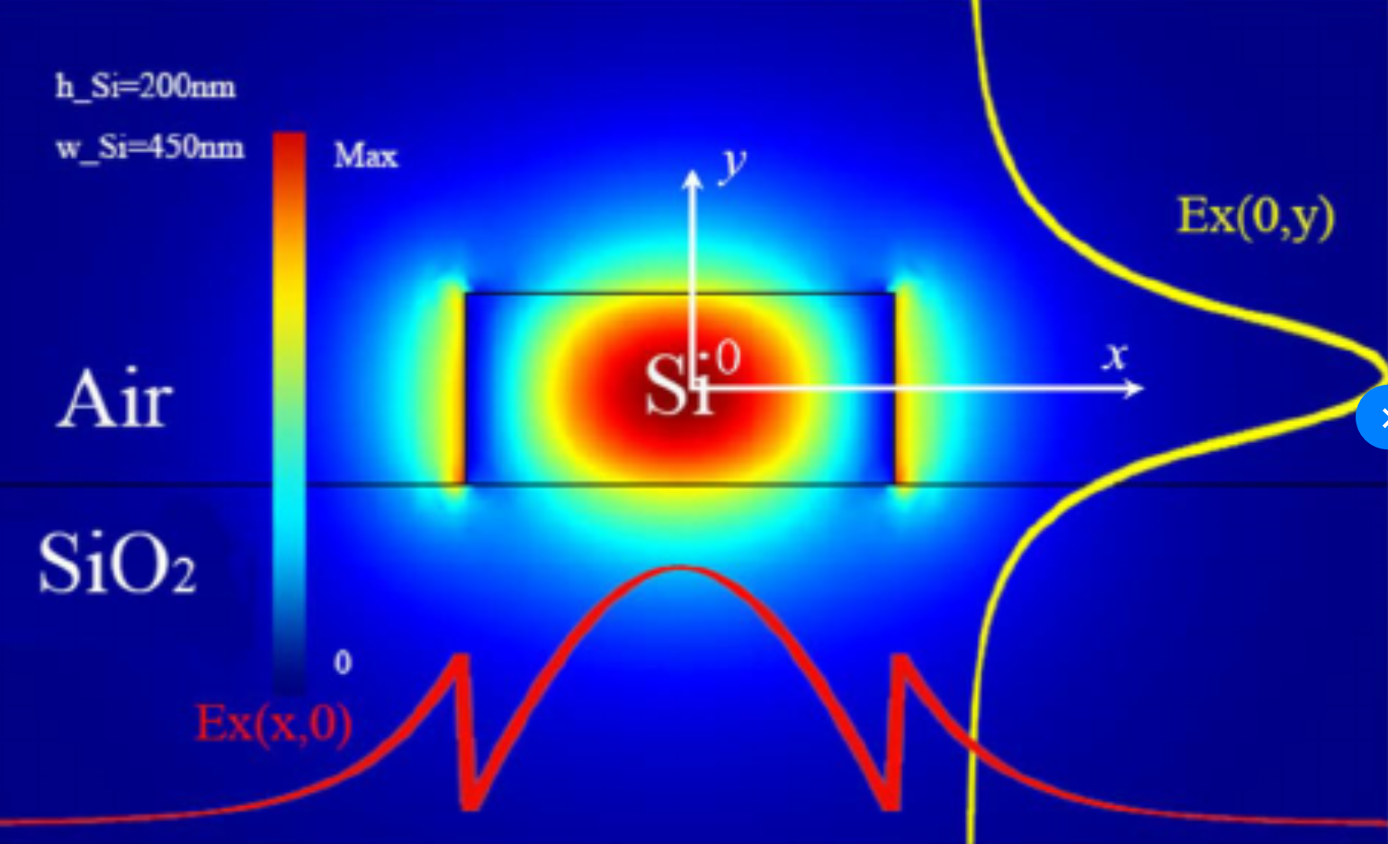

Electromagnetic Modes
MODES: Stable electric field distributions in waveguides, optical resonators or in free space that satisfy Maxwell’s equations and boundary conditions
WAVEGUIDE MODES: Solution of the wave equation that satisfies the boundary conditions and has a spatial distribution does not change with propagation
Confined structures: Waveguide Modes
For dielectric waveguides, like glass optical fiber, the field and energy exists in the cladding
For cylindrical dielectric waveguides the modes are described by Bessel functions
The lowest order mode is approximately Gaussian
A waveguide has only a finite number of guided propagation modes for a specified wavelength, the intensity distributions have a finite extent around the waveguide core
Dielectric Waveguide

Slide 10
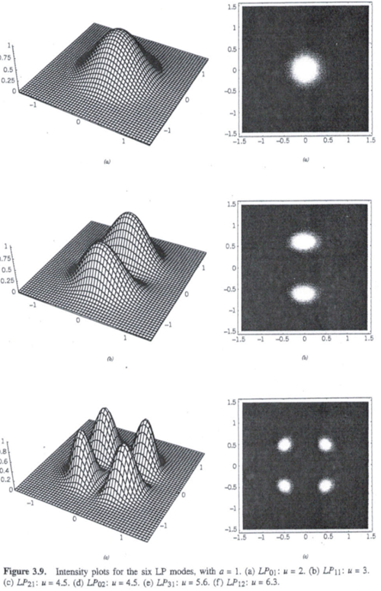
Electromagnetic Modes
MODES: Stable electric field distributions in waveguides, optical resonators or in free space that satisfy Maxwell’s equations and boundary conditions
Confined structures: Waveguide Modes
For cylindrical dielectric waveguides the modes are described by Bessel functions, however the lowest order mode is nearly Gaussian
A waveguide supports only a finite number of guided propagation modes for a specified wavelength and waveguide size
Dielectric Waveguide
Note: Free-space also has stable modes including plane Waves and Gaussian beams

Slide 11
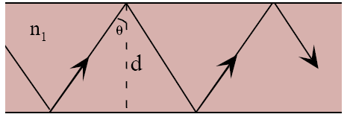
Transverse Resonance Condition
The transverse resonance condition is an analytical technique used to determine the propagation constants and mode conditions in waveguides
The effects of the boundary conditions may be viewed as a requirement on the roundtrip phase across the waveguide
A guided wave must form a self‑consistent standing wave pattern in the transverse direction (perpendicular to propagation)
In the ray picture the wave accumulates phase as it travels across the core
It also acquires additional phase shifts upon reflection at the cladding boundaries
Phase shift for passing through core
Phase shift due to TIR at core-cladding interface
Phase shift due to TIR at core-cladding interface
n₁k₀
TRC: For a mode to exist, the total round‑trip phase shift in the transverse direction must equal an integer multiple of 2π
This restricts the allowed values of k_{x} and hence only discrete values of β are allowed
The TRC is also a dispersion relation
Note φ are sometimes written as -2Φ
κ = k_{x}
β

Slide 12
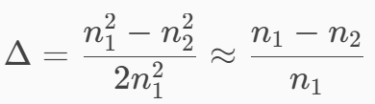
Types of Fiber: Core Size
Ray Picture
Intensity Profiles
Multimode Fiber
Core n1= ~1.480-1.500
Cladding n2= ~1.444
Δ ≈ 0.01 to 0.03
Lowest order Mode
Δ ≈ 0.01 to 0.02
Single Mode Fiber
Core n1= ~1.450
Cladding n2= ~1.444
Δ ≈ 0.0036 to 0.004
Index contrast
Waveguides support modes that satisfy the EM boundary conditions between the core and cladding
Very small cores only support one transverse mode (even the smallest core supports at least one mode)
Larger cores support many transverse optical modes that exhibit different (more complex) intensity profiles

Slide 13
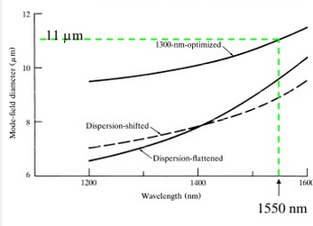
Mode Size vs. Wavelength
For a given mode, the distribution of field (and power) changes with wavelength
core
n₁
n₂
λ=1650nm
λ=1550nm
λ=1320nm
For low frequencies (large λ) the mode is spatially large and extends significantly into the cladding thus the effective index is very close to that of the cladding n₂
For high frequencies (short λ) the mode is spatially confined mostly to the core thus the effective index is very close to that of the core n₁

Slide 14
Dispersion β vs ω
n₂ < n₁
Knowledge of β(ω) is required to understand signal propagation
β = n₁ ω/c
β
β(ω)
Radiation modes
β = n₂ ω/c
n₁ and n₂ are functions of ω
In the figure we neglect this dependence
ω
For low frequencies (large λ) the mode is spatially large and extends significantly into the cladding thus the effective index is very close to that of the cladding n₂
For high frequencies (short λ) the mode is spatially confined to the core thus the effective index is very close to that of the core n₁

Slide 15
Fiber Modes

Slide 16
Fiber Modes and Waveguide Dispersion (summary)
For a given mode, the group velocity depends on the wavelength (even if the material dispersion is negligible)
The precise mode field distribution changes slightly when the wavelength changes
The relative fraction of the electric field in the core versus cladding changes
Thus the effective index changes and the group velocity must change
We need to determine the mode field profile and β(ω) in fibers
The solution is analytic for step index fibers but is typically solved numerically
We start with the wave equation (Helmholtz equation) in cylindrical coordinates
The 3D wave equation
becomes:
We have written just the axial component E_{z}, there are of course six variables E_{z}, E_{ρ}, E_{φ} and H_{z}, H_{ρ}, H_{φ ,} but only two are independent
The frequency dependence is not explicitly written
k_{ο} = 2π/λ_{ο}
Equivalent to Keiser Eq 2.36

Slide 17
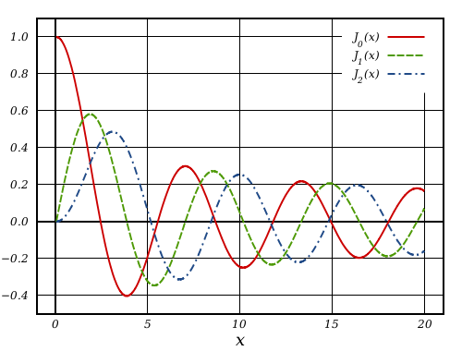
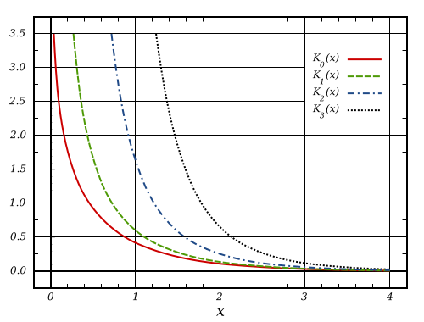
Optical Fiber Modes
The optical fiber has a circular waveguide
Solve Maxwell’s equations with cylindrical symmetry
Solutions vary with radius ρ and angle φ
Fields in the core are non-decaying
Fields in the core have a ρ as
J, Y Bessel functions of the first and second kind
Fields in the cladding are decaying
A boundary condition is E⇒0 as ρ⇒∞
K modified Bessel functions of second kind
In a rectangular system the fields decay exponentially
There are two mode number to specify each distinct mode
n is the radial mode number or mode index
m is the angular mode number or azimuthal mode index

Slide 18
Finding the Solution
Separation of variables suggests
Resulting in 3 separate equations (ODEs), one for each variable
Equation for ρ dependence has Bessel function solutions
J, Y, K and I, are types of Bessel functions and A, A’, C, and C’ are constants
Equivalent to Keiser Eq 2.38
β is a separation constant
m² is a separation constant
Keiser’s q²
Ζ dependence is identical to plane wave
φ dependence is periodic in φ
The solutions to this are Bessel functions
(note: n here is index of refraction)

Slide 19
Solution
In the core the propagation constant β is related to the free space wavevector:
In the cladding the evanescent decay constant
Boundary conditions (field must be finite and go to zero as ρ->∞ )
Similar relationships exist for H_{z}
Using Maxwell’s Equations, expressions can be determined for, E_{ρ}, E_{φ} and, H_{r}, H_{φ} in terms of E_{z} and H_{z}
n₁k₀
κ
β
n₂k₀
γ
β

Slide 20
Eigenvalue Equation for β
Using the boundary conditions for continuous tangential E and H across the core-cladding interface gives four equations for continuity of E_{z}, E_{φ}, H_{z}, and H_{φ}
These four equations have solution when the determinant of the corresponding matrix is zero, yielding:
Keiser 2.54
This provides a method to determine β for any given set of k_{o}, a, n₁ and n₂
There are multiple solutions for each azimuthal mode index m, m = 0, 1, 2, 3…
The solutions are identified in terms of m and n and β_{mn}
Where n is the radial mode index, n = 1, 2, 3 ….
In general E_{z} and H_{z} are both non zero except for m = 0
We therefore call these hybrid modes designated HE_{mn} and EH_{mn} depending on whether H_{z} is > E_{z} or not
For m=0 we do have TE_{0n} and TM_{0n}

Slide 21
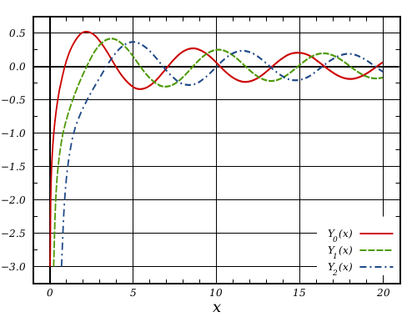
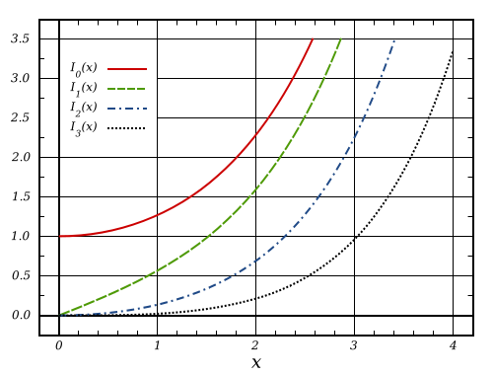
Bessel Functions
Bessel functions of the first kind: J_{α}
1st kind
2nd kind
Bessel functions of the second kind : Y_{α}
Modified Bessel functions: I_{α}, K_{α} special case with purely imaginary argument

Slide 22
Ray Picture
A meridional ray has no φ component –it passes through the z axis
Ray propagation with a component in the φ direction, is called a skew ray
Skew rays exhibit a spiral-like path down the core, never crossing the z axis
(n1k0)²= βr²+ βφ²+ β²= βt²+ β²
TE (E_{z}= 0) and TM(H_{z}= 0) modes are possible
These modes correspond to meridional rays and pass through the fiber axis
We refer to these modes as TE_{lm} and TM_{lm} modes
Two indices to describe the two degrees of freedom

Slide 23
Hybrid Modes
Hybrid modes: both E_{z} and H_{z} are nonzero
These are skew rays (helical path without passing through the fiber axis)
The modes are written as HE_{lm} and EH_{lm} depending on whether the components of H or E make the larger contribution to the transverse field
The full set of circular optical fiber modes therefore comprises: TE, TM (meridional rays), HE and EH (skew rays) modes

Slide 24
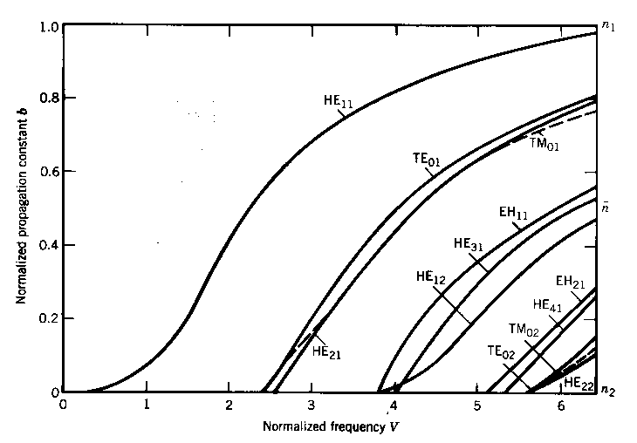
Effective Index and V Number
Each mode is uniquely characterized by a specific β(ω)
We can therefore define a mode index of refraction (mode index)
The mode propagates with the effective index constrained by the core and cladding indices:
The mode reaches cutoff when γ=0 or
We also define a normalized frequency V
Δ = (n₁-n₂)/n₁
HE₁₁ is a hybrid mode and it has the lowest cutoff (at V=0), i.e. does not cutoff
And normalized propagation constant b:
Approx V for SSMF
The behavior of β vs. V depicts the fiber mode structure
When TE₀₁ and TM₀₁ modes reach cutoff then the fiber is single mode
This is equivalent to J_{o}(V)=0
or V < 2.405

Slide 25
Waveguide Dispersion
Waveguide dispersion is generally the smallest contributor to the total dispersion
It can dominate near the dispersion minimum i.e. λ=1300nm for single mode waveguide
It must be included since it typically shifts the dispersion dominated by material dispersion
Waveguide dispersion: wave vector varies with wavelength
In order to determine waveguide dispersion we must return to the eigenvalue equation which defines the allowed modes
The EV equation was written in terms of the transverse wavevector κ
The transverse wavevector depends on:
When the wavelength changes, k_{o} changes and hence the propagation constant β must change
κ is fixed for a particular mode, it is a solution to the EV equation
The mode shape stays essentially the same when the wavelength changes [we are assuming that the wavelength changes are small, consistent with that needed to support data streams]

Slide 26
Weakly Guided modes
For telecom Special case of cylindrical modes
Typical of all common optical fibers index contrast is low fibers Δ<< 1
Weakly guided modes n₁~ n₂, determinant equation simplifies, modes become degenerate
E_{z} and H_{z} are both nearly zero
Designated LP modes for Linearly Polarized
The propagation is preferentially along the fiber axis and the field is predominantly transverse
Modes are approximated by two linearly polarized components
both E_{z} and H_{z} are approximately zero)

Slide 27
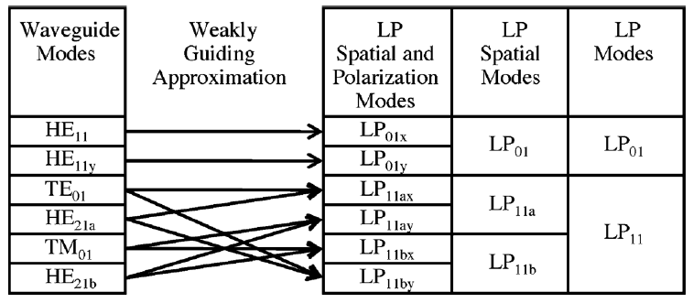
Fiber LP modes
Relation between the LP modes and the “real” exact waveguide modes HE_{11x}, HE_{11y}, TE₀₁, TM₀₁, HE_{21a}, and HE_{21b} of the six-mode FMF

Slide 28
LP modes: Normalized Propagation Constant
Fig 2.16 Kumar and Deen

Slide 29
Intensity profiles for the lowest LP modes
Two polarizations each

Slide 30
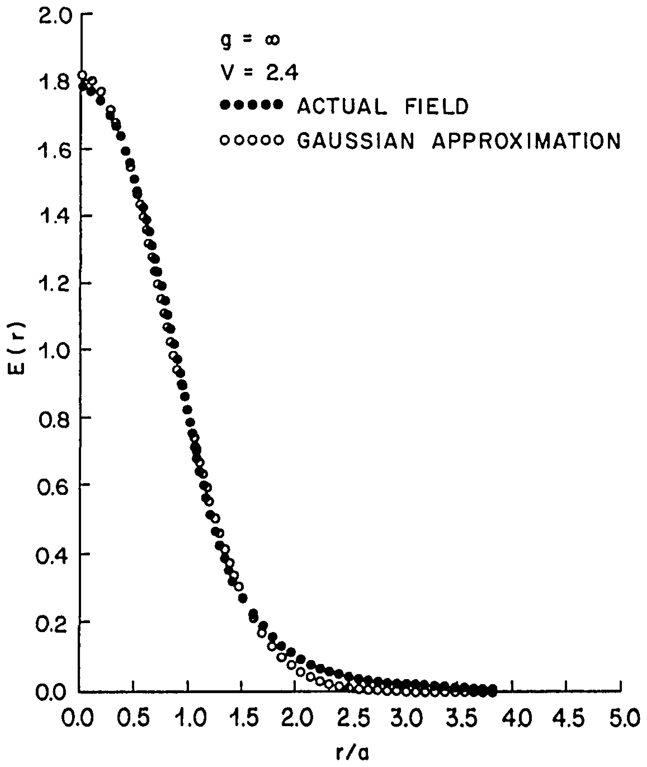
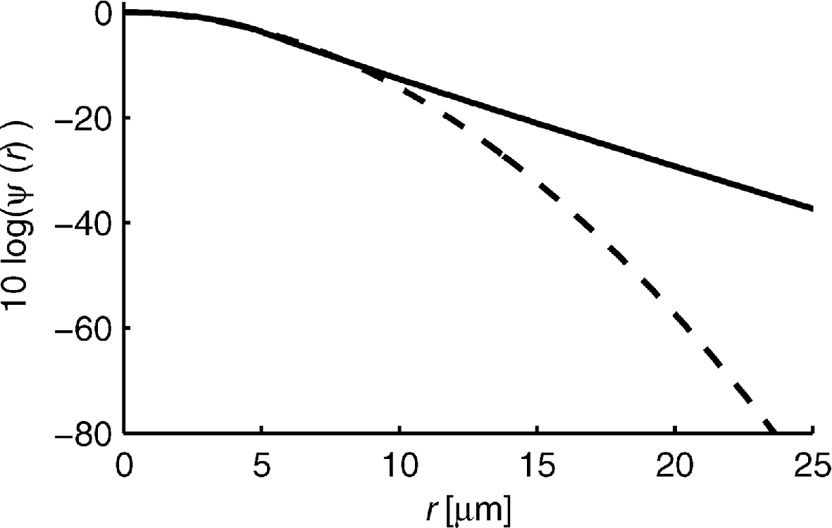
Gaussian Approximation for the LP₀₁mode
E(r) = E(0) exp (-r² / w₀²)
I(r) = I(0) exp(-2r²/w₀²)
FIG. 8 Citation D. Marcuse, "Gaussian approximation of the fundamental modes of graded-index fibers," J. Opt. Soc. Am. 68, 103-109 (1978); https://www.osapublishing.org/josa/abstract.cfm?uri=josa-68-1-103
Fig. 2 Citation Vincent Trudel, Yves St-Amant, "One-dimensional single-mode fiber-optic displacement sensors for submillimeter measurements," Appl. Opt. 48, 4851-4857 (2009); https://www.osapublishing.org/ao/abstract.cfm?uri=ao-48-26-4851
The LP₀₁ mode intensity varies with radius as J₀²(ur/a) inside the core and as K₀²(wr/a) in the cladding
The resultant intensity profile closely fits a Gaussian function width w₀, known as the mode-field radius defined as the radial distance from the core center to the 1/e² point of the intensity profile

Slide 31
More on Guided Modes

Slide 32
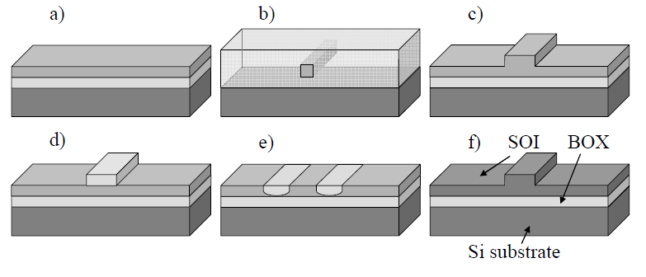

Planar Guided Wave Structures
Top cladding
Waveguide core
Lower cladding
buried oxide
a) Slab waveguide b) strip waveguide c) rib waveguide
d) strip-loaded waveguide e) diffused waveguide f) rib-type SOI waveguide

Slide 33
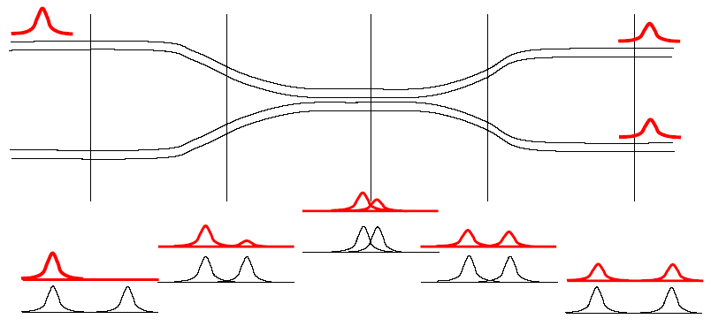
Coupling Between Adjacent Waveguides
Two adjacent optical modes exchange power
Phase matching
Spatial overlap
Directional coupler: no power is coupled into backward waves
3dB coupler: input power is equally split between two output guides

Slide 34
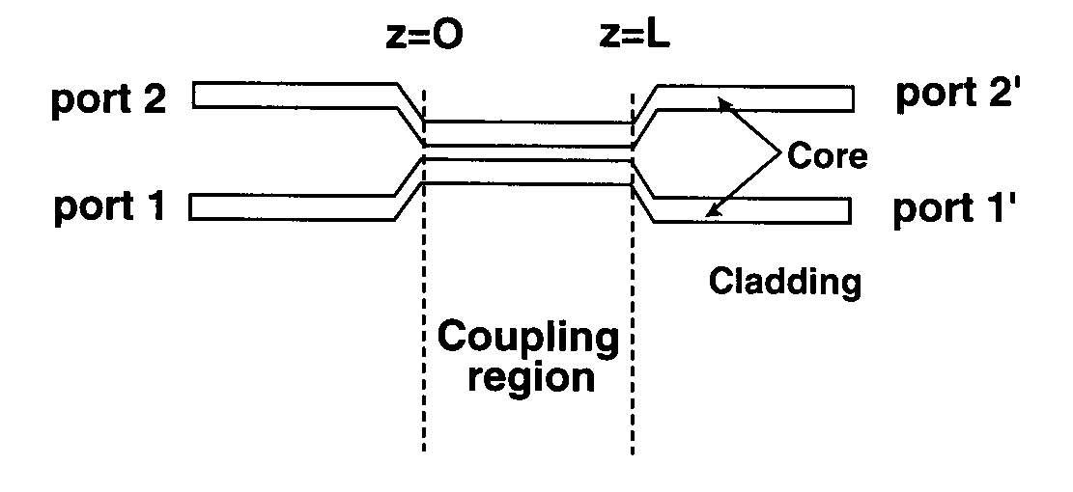
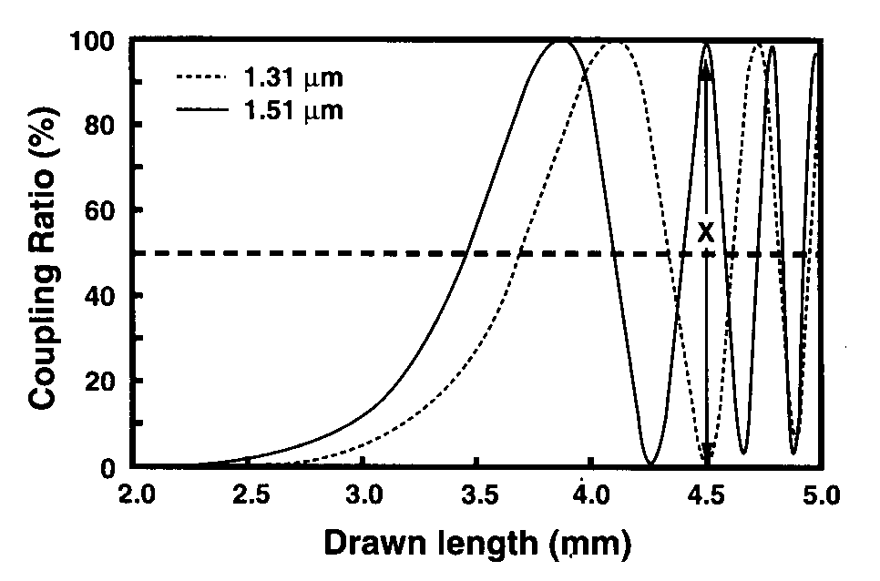
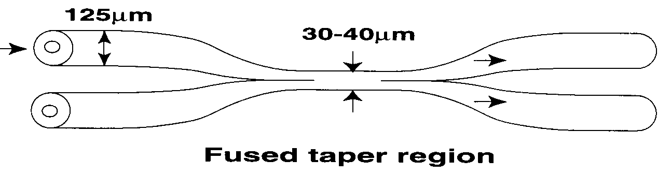
Optical Couplers
Planar coupled waveguides
Fused biconical fiber coupler
Length determines coupling ratio
2x2 couplers
Waveguides are tapered, V number decreases, expanding evanescent field
Controlling parameters
Size of reduced waveguide, coupling region length, difference in waveguide size
Coupled mode theory allows a description of the wave transverse overlap
Relative phase of each input mode is critical to performance

Slide 35
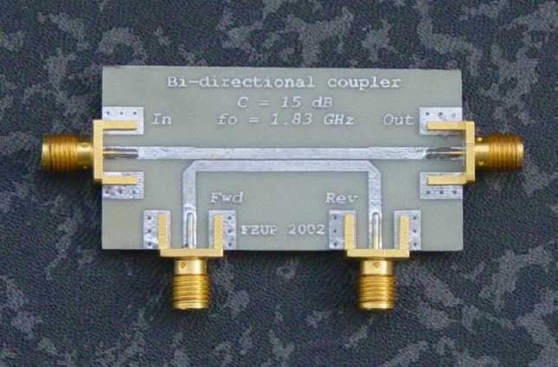

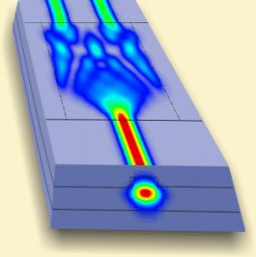
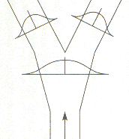
Couplers
RF: microstrip
RF: metal waveguide
Optical: index guided

Slide 36
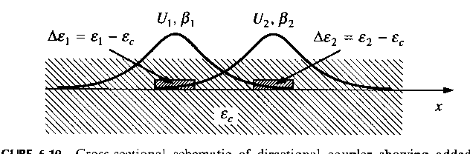
Co-directional coupling
For coupling between the modes we need to add a dielectric perturbation to the wave equations
Without the dielectric perturbation the situation is just two waves passing each other in a dielectric
Δε₂ acts as a perturbation for E₁
Δε₁ acts as a perturbation for E₂
The polarization perturbation is of the form

Slide 37
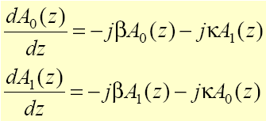
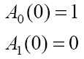
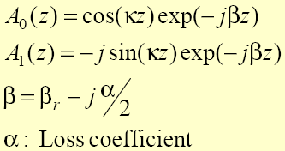
Coupled mode theory; Two identical waveguides
Using the wave equation, we find added source terms which originate from both waveguides
E(x,y,z)=A(z)E(x,y)
A(z): complex field amplitude including a phase term e^{-jβz}
E(x,y): Field distribution in one waveguide
New source terms
Couple Mode Equations
β is the same for both waveguides (synchronous case)
Initial conditions
Solutions
κ: Coupling coefficient
driven waveguide lags 90° behind phase of driving waveguide

Slide 38
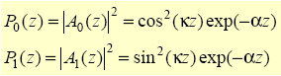
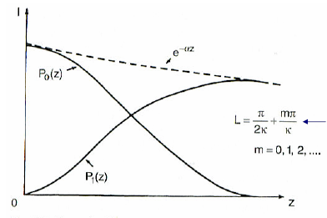
Power Transfer: Synchronous case
Power Flow
Periodic
When κz=π/2 all power is transferred
Length needed to transfer all power from one waveguide to the other
Calculated power distribution along the length of the waveguide

Slide 39
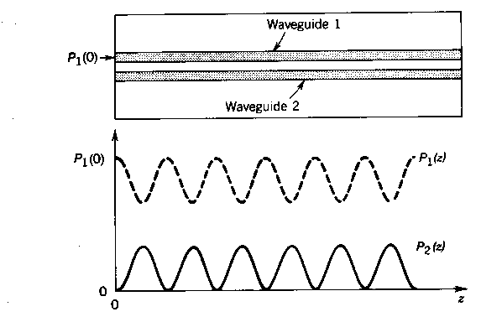
Periodic Exchange of Power
In the absence of loss the power exchange continues indefinitely
Coupling between two modes is not symmetric, κ_{υμ} ≠ κ∗_{μν}, unless β_{υ} = β_{μ}
For synchronous waveguides the coupling is complete
For asynchronous waveguides complete power transfer does not occur
For both cases the power transfer is periodic
Asynchronous case

Slide 40
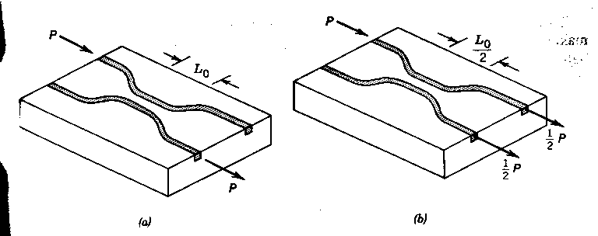
Optical Couplers
Couplers length depends on the need
a) complete switching of power from one guide to the other
b) splitting the power half and half i.e. a 3dB coupler
Can also create other couplers 10%, 5% etc
Dynamic coupler made by changing Δβ using electro-optic effect
NB: there is a relative phase change between the two outputs and the relative input phase matters
This impacts how you cascade these devices

Slide 41
Optical Signal Control: Scattering Matrix Representation
Optical Hybrids
E_{1,in}
E_{1,o}
E_{2,in}
E_{2,o}
Where κ is the coupling coefficient
For κ l = π/4 the device is a 3dB coupler
Each term then has magnitude

Slide 42
Optical Signal Control: Scattering Matrix Representation
Optical Hybrids
E_{1,in}
E_{1,o}
E_{2,in}
E_{2,o}

